Slide 1
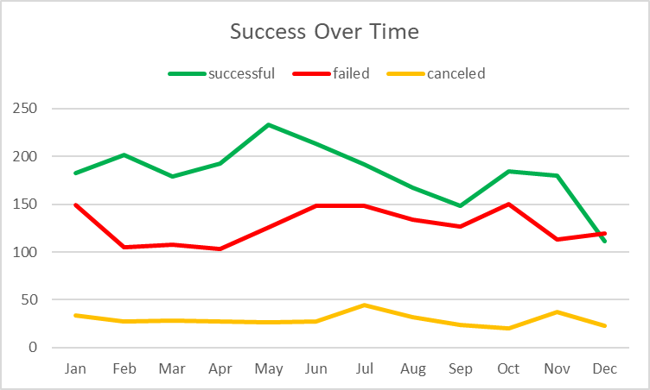
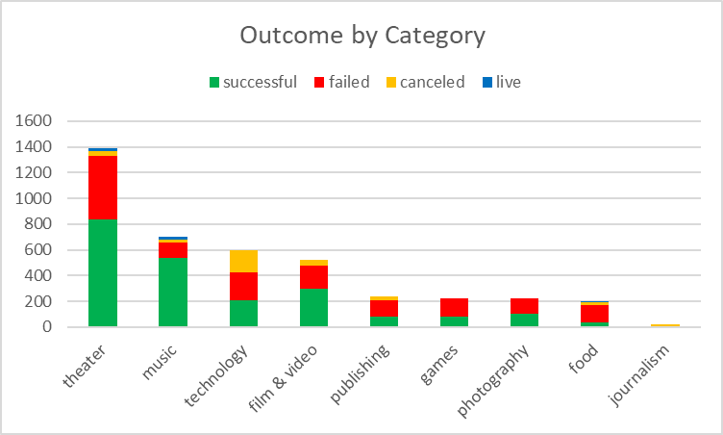
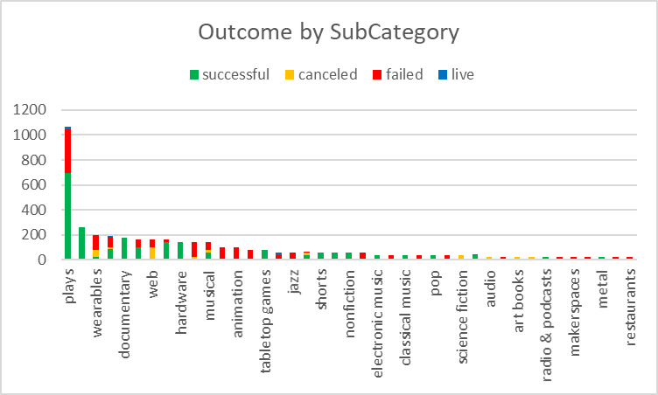
Kickstarter Campaign Summary
Most Kickstarter campaigns are seeking funding for Theater/Plays, 30 days in length
June is the most common start month of all campaigns with 388, December is the least with 253 and the average monthly is 342
Staff Picks are successful 90%

